Slide 1
Module 5
Syllabus
Data-flow computers - Data driven computing and Languages - Data flow computers architectures - Static data flow computer -Dynamic data flow computer -Data flow design alternatives.

Slide 2
Program
memory
a=(b+1)*(b-c)
Program memory
Fork a
Data
memory
Data
memory
+
b
1
t1
+
b
1
t1
b
b
α
t1
α
Goto β
t1
-
b
c
t2
α+1
c
-
b
c
t2
c
t2
*
t1
t2
a
t2
α+2
a
Join 2
β
*
t1
t2
a
a
Sequential control flow
Parallal control flow

Slide 3
(b)
(c)
+ ( ) 1 β/1
- ( ) ( ) β/2
* ( ) ( ) δ/1
(a)
Instruction execution in a data flow for the computer
for computation of a=(b+1)*(b-c) by data forwarding

Slide 4
(3)=b
(5)=c
+(1)
-
Step 1
*
(5)=c
+(1)
-
(4)
(-2)
Step 2
*
+(1)
-
Step 3
*
(-8)=a

Slide 5
Static dataflow computer organization
Memory unit
(instructions)
Update
unit
Fetch
unit
(Instruction address)
Data
tokens
Processing unit
(processors)
Enabled
Instruction queue

Slide 6
Dynamic dataflow computer organization
Memory unit
(instructions)
Matching
unit
(Matched token sets
Update/
fetch unit
Processing unit
(Processors)
Data
tokens
Enabled
Instruction queue

Slide 7
A ring structured data-flow computer organization
including the I/O functions
Input
Output
Input-output section
(token matching)
Routing network
Memory section
(instructions)
Processing section
(Processors)
(Data tokens)

Slide 8
P = X + Y
Q = P / Y
R = X * P
S = R – Q
T = R * P
U = S / T
f(X,Y)=(X * (X+Y)-(X+Y)/Y)/(X * (X+Y) * (X+Y))

Slide 9
X
Y
+
P
*
/
Q
R
-
*
S
T
/
U

Slide 10
Nodes and links for construction of the dataflow graphs
Data link
Boolean link
Identity
Decider
Operator
f
I
T gate
F gate
Merge
T
F
T F

Slide 11
Input x,n
Y=1;i=n;
While i > 0 do
Begin y=y*x;i=i-1; end
z=y
Output z

Slide 12
X
1
n
T F
false
T F
false
T F
false
i
>0
T
F
T
T
*
-1
z

Slide 13
Static dataflow computer
architecture
Processing
unit
Processing
unit
(Control
tokens)
Control
network
(Data
tokens)
(Operation
packets)
Instruction
Cell block
Distribution
network
Arbitration
network
Instruction
Cell block
Memory section

Slide 14
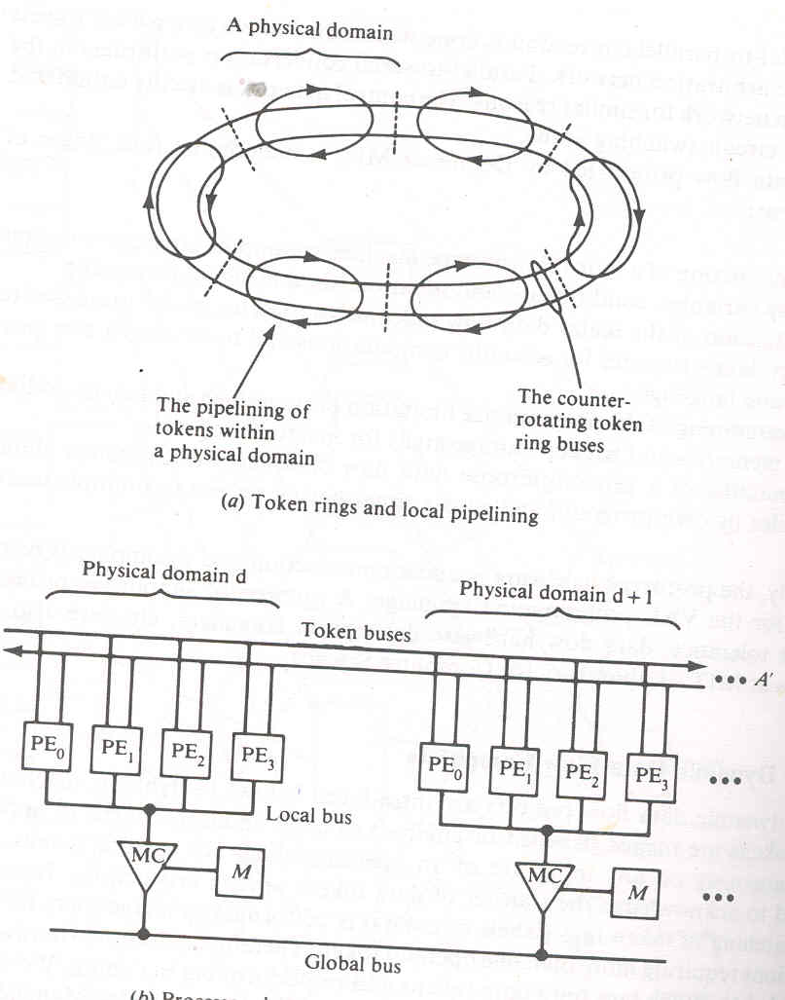
Irvine dataflow computer

Slide 15
PE
0
N x N network
0
PE
1
1
PE
N-1
N-1
Arvind's data flow machine

Slide 16
op
nc
nd
c1
Constants
c2
(s ,p , nt , af)
Destinations
(s' ,p' , nt' , af')
(s'' ,p'' , nt'' , af'')
A typical instruction in an Arvind's machine

Slide 17
I/P
Waiting matching
section
Program and
Data memory
Instruction fetch service
I structure memory
Service section
(ALU PE mapping)
O/P

Slide 18
Comparison between data-driven and dependence-driven computing models
(Dependence-driven)
Ordinary language program
(Dependence-driven)
Ordinary language program
(Data-driven)
Data-flow language program
Program normalization
Dependence graph
generation
Dependence graph
generation
Dependence graph
Arc and node
transformation
Code generation
Code generation
Machine with structured
Control h/w
Machine with decentralized
Control h/w

Slide 19
Global controller
Processor
cluster
Processor
cluster
Processor
cluster
Interconnection network
Shared memory space

